Slide 1

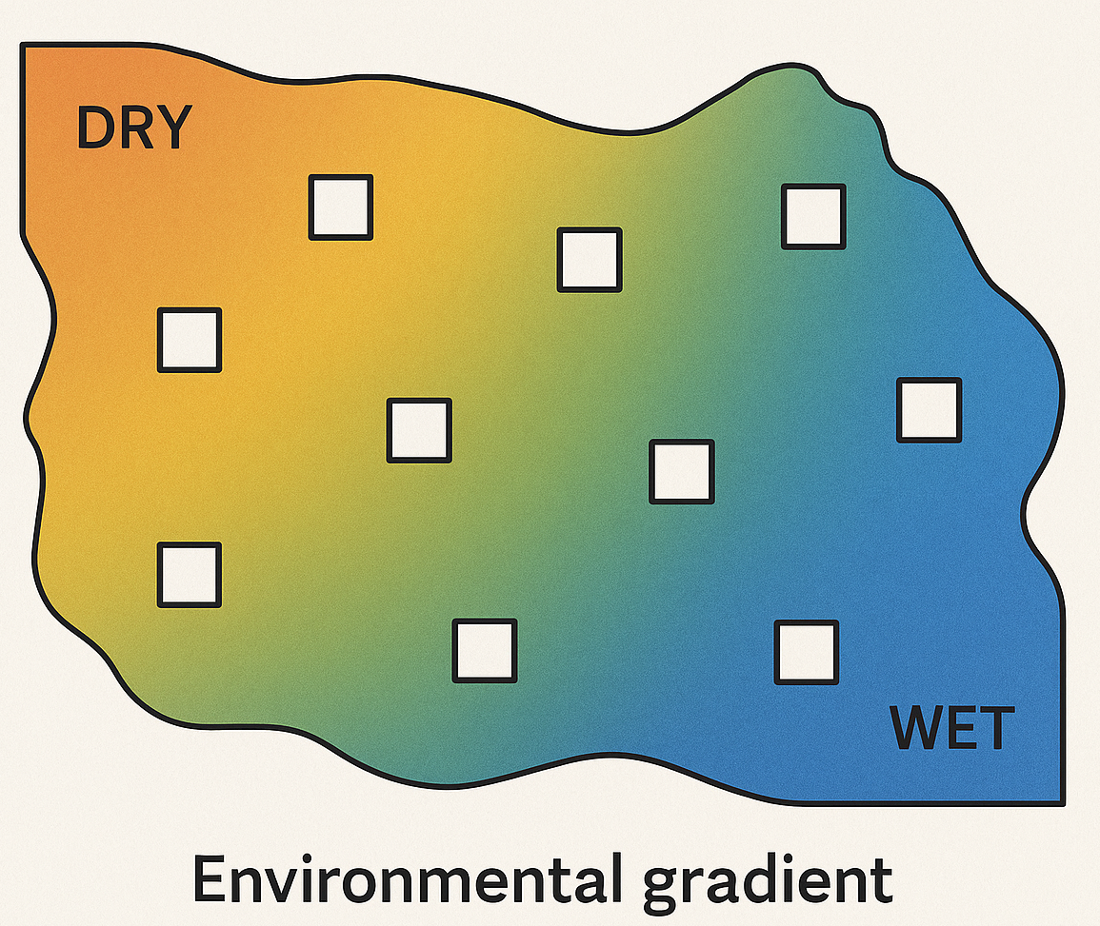

Slide 2
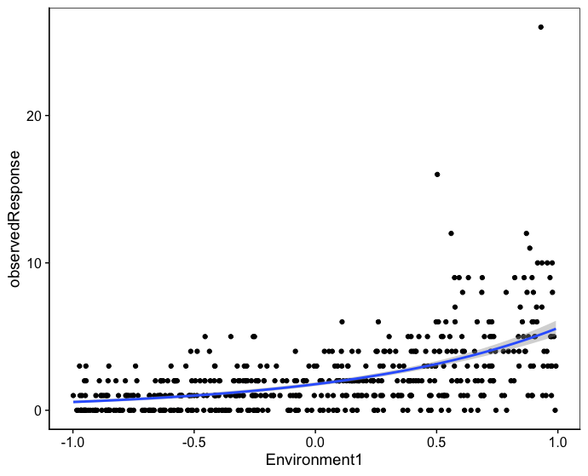
Poisson variance
Extra-Poisson variance – increases with Environment

Slide 3
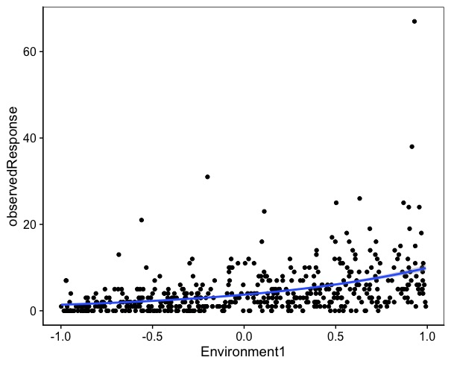
Poisson variance
Extra-Poisson variance

Slide 5
